Slide 1
Nuclei
You need 100% in this then all is fine

Slide 3
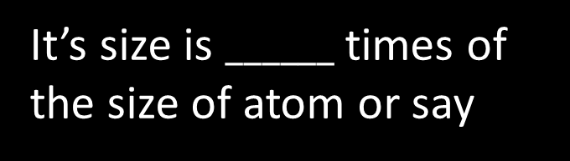


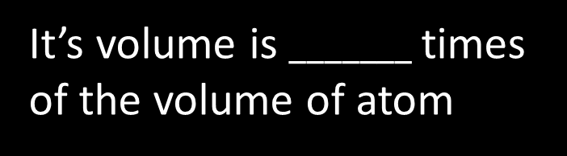
Nucleus
This is called _________
$${10}^{−4}$$
It’s size is $______$ times of the size of atom or say
$${10}^{−12}$$
It’s volume is $_______$ times of the volume of atom
It consist of
Proton and neutron
Can not have electron inside it.

Slide 4
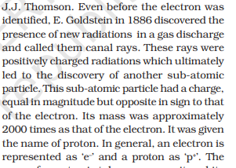
Who discovered
Electron
J J Thomson
Proton
E. Goldstein
Ernest Rutherford
Nucleus
Ernest Rutherford
Neutron
James Chadwick who observed emission of neutral radiation when beryllium nuclei were bombarded with alpha-particles
James Chadwick

Slide 5
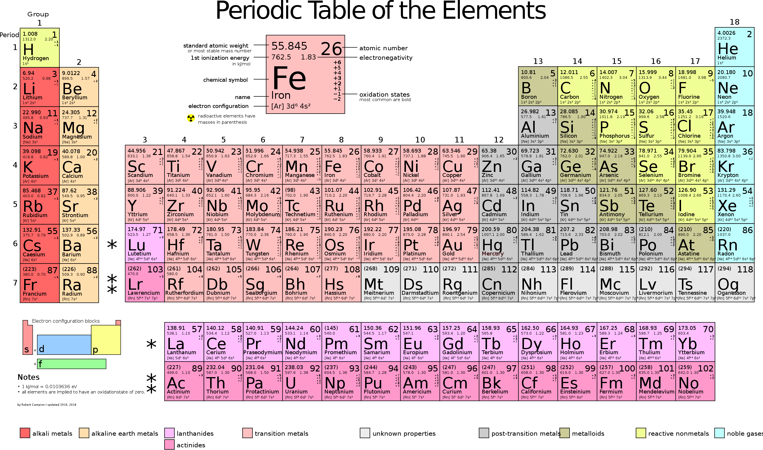

$${}_{Z}^{A}X$$

Slide 6
Nuclear notation

Slide 7
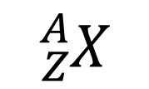

Nuclear notation
Atomic Mass number
Total number of proton(Z or P) and neutron(N) called nucleon
$${}_{Z}^{A}X$$
Atomic Number
Total number of proton
$$Atomic mass is just mass of atom$$

Slide 8
Type of nuclei

Slide 9



Type of nuclei
$$_{6}^{14}A ,_{7}^{14}B ,_{8}^{14}C ,_{7}^{15}D$$
Isotopes
Same Proton
Isotones
Same Neutron
Isobars
Same Atomic mass
Mirror Nuclei
Isodiapheres
Same N-Z
$$Z_{number}→N_{number}$$
$$N_{number}→Z_{number}$$
In this case element is same

Slide 10
What is 1amu

Slide 11
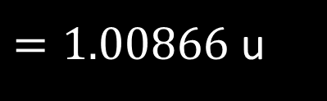
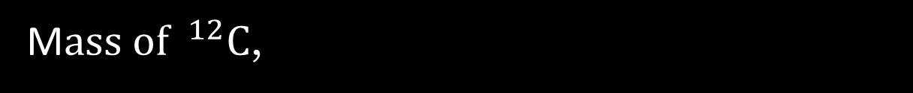
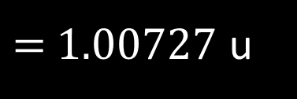
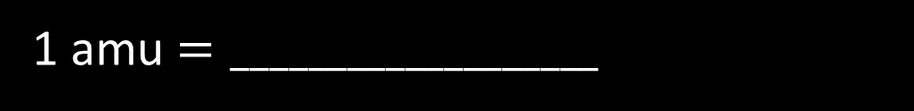




What is 1amu
It is defined as one-twelfth the mass of a carbon-12 atom
M$ass of ^{12}C$,
1 amu $=___________________$
$$12$$
$$m_{p}$$
$=$ 1.00727 u
$$m_{n}$$
$=1.00866$ u
$$m_{n}>m_{p}$$

Slide 12
Average atomic weight of Isotope

Slide 13


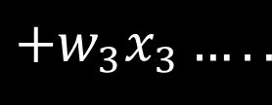
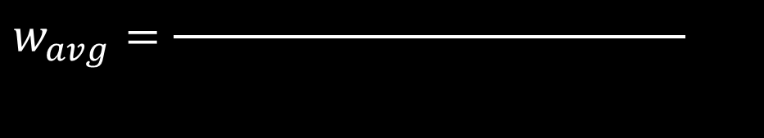

Average atomic weight of Isotope
Here we take weighted average
$$w_{1}x_{1}$$
$$+w_{2}x_{2}$$
$$+w_{3}x_{3}…..$$
$$w_{avg}=\frac{ }{ }$$
$$100$$

Slide 14









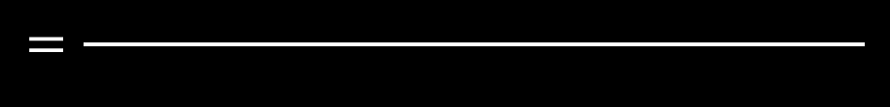











Question
Find average atomic weight of X if it exist in three form’s 22.06,22.94 and 23.06 in percentage 22%,40%,38%
Solution
$$22.06$$
$$×22$$
$$+22.94$$
$$×40$$
$$+23.06$$
$$×38$$
$$W_{avg}=\frac{ }{ }$$
$$100$$
$$0$$
$$×22$$
$$+ 0.88$$
$$×40$$
$$+1$$
$$×38$$
$${or W}_{avg}with base 22.06=\frac{ }{ }$$
$$100$$
$$0$$
$$+ 35.2$$
$$+38$$
$$=\frac{ }{ }$$
$$=0.732$$
$$100$$
$$W_{avg}=22.06+0.732=22.792$$

Slide 15
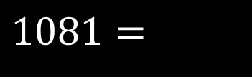










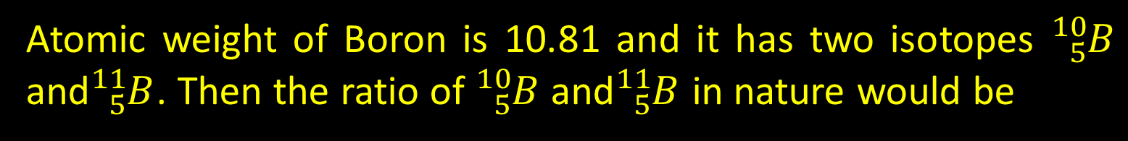






















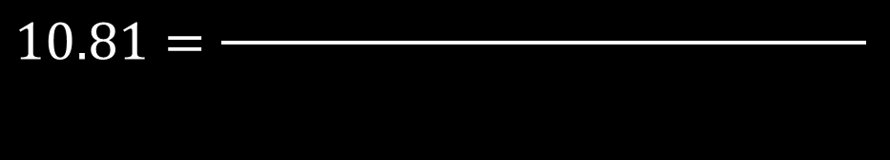
Question
Atomic weight of Boron is 10.81 and it has two isotopes ${}_{5}^{10}B$ and${}_{5}^{11}B$. Then the ratio of ${}_{5}^{10}B$ and${}_{5}^{11}B$ in nature would be
$$+w_{2}x_{2}$$
Shortcut
$$w_{1}x_{1}$$
$$+w_{3}x_{3}…..$$
$$w_{avg}=\frac{ }{ }$$
$$100$$
$$10.81$$
$$10$$
$$−−−−−−−−−−−−−−→$$
$$11$$
$$10×x$$
$$+11×$$
$$(100−x)$$
$$81\%$$
$$19\%$$
$$10.81=\frac{ }{ }$$
$$100$$
$$10.8$$
$$10$$
$$−−−−−−−−−−−−−−→$$
$$12$$
$$1081=$$
$$+1100$$
$$−11x$$
$$10x$$
$$60\%$$
$$40\%$$
$$10.6$$
$$x=$$
$$−−−−−−−−−−−−−−→$$
$$13$$
$$19\%$$
$$10$$
$$80\%$$
$$20\%$$

Slide 16
(In Greek, isotope means the same place, i.e. they occur in the same place in the periodic table of elements.)
It was found that practically every element consists of a mixture of several isotopes
The two isotopes of hydrogen are called deuterium and tritium. Tritium nuclei, being unstable, do not occur naturally and are produced artificially in laboratories
Prescence of isotopes give hint of existence of neutron.

Slide 17
Size of nucleus

Slide 18
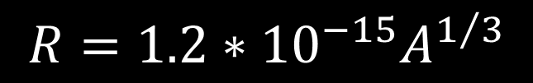




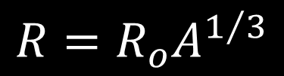





Size of nucleus
#For radius
#For Density
$$∝A$$
$$R=R_{o}A^{1/3}$$
$$ρ=\frac{mass}{vol}$$
$$R=1.2∗{10}^{−15}A^{1/3}$$
$$∝R^{3}$$
$$∝{(A^{1/3})}^{3}$$
$$∝A$$
$$\frac{R_{1}}{R_{2}}=$$
$${\left(\frac{A_{1}}{A_{2}}\right)}^{1/3}$$
$$=Constant$$
$$≈{2.3×10}^{17}$$

Slide 19




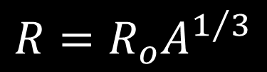

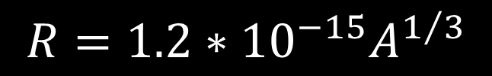
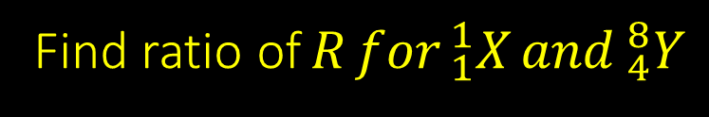

Question
$$R=R_{o}A^{1/3}$$
Find ratio of$R for _{1}^{1}X and _{4}^{8}Y$
$$\frac{R_{x}}{R_{y}}={\left(\frac{1}{8}\right)}^{1/3}$$
$$R=1.2∗{10}^{−15}A^{1/3}$$
$$\frac{R_{1}}{R_{2}}=$$
$${\left(\frac{A_{1}}{A_{2}}\right)}^{1/3}$$
Question
What is ratio of density for ${}_{1}^{1}H$as compared to${}_{92}^{235}U$
$$\frac{ρ_{H}}{ρ_{U}}=\frac{1}{1}$$
$$ρ=\frac{mass}{vol}$$
$$=Constant$$

Slide 20
Nuclear force

Slide 21
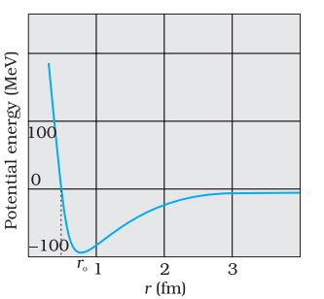




Nuclear force
small
Range of nuclear force is ________
$${10}^{−15}$$
Range of Strong nuclear force is ________
$${10}^{−16}$$
Range of week nuclear force is ________
Attractive
In general nuclear force is _________ in nature but if distance is _________ it become __________
0.8 fermi
repulsive
independent
Nuclear force is charge ____________ i.e. Nuclear force between
$$= =$$
$$F_{pp} F_{pn} F_{nn}$$

Slide 22














$$> <$$
$$F_{pp} F_{pn} F_{nn}$$
$$< =$$
$$F_{pp} F_{pn} F_{nn}$$
$$> =$$
$$F_{pp} F_{pn} F_{nn}$$
$$= =$$
$$F_{pp} F_{pn} F_{nn}$$
Question
Which of the following order of force is correct between proton and neutron in atom.
$$< =$$
$$F_{pp} F_{pn} F_{nn}$$
Question
Which of the following order of nuclear force is correct between proton and neutron in atom.
$$= =$$
$$F_{pp} F_{pn} F_{nn}$$
Question
If the two particle are placed 1m apart then what is the order of force in between them
$$> =$$
$$F_{pp} F_{pn} F_{nn}$$

Slide 23
Nuclear force
do not Follow
Nuclear force ___________ superposition
Is not
Super position _____ property of vector
Non-Conservative
Force is __________________ in nature (conservative/Non-conservative)
do not Follow
_______________inverse square law
Non- central
Force is ____________ (central/non central)

Slide 24




Nuclear force :Strength comparison
Strong nuclear force is stronger than electromagnetic
Strong nuclear force
$$1$$
Electromagnetic Force
$${10}^{−3}$$
Week nuclear force
$${10}^{−13}$$
Electromagnetic force is stronger than gravitational force
Gravitational Force
$${10}^{−39}$$

